Slide 1
Short Transmission Line Examples
Source impedance:
ECL = 10 ohms
TTL/CMOS = 30 ohms
Lossless, distortionless transmission line
Load impedance
RL = 10K
CL = zero or 20 pF
Unit
step
IDEAL risetime = 6 x (line delay)

Slide 2
It’s the Risetime/Delay Ratio that Counts
delay
10
9
ZS
=
10
RL
=
1
4
Set nominal transmission
10
line delay and risetime
.
risetime
2
delay
ZC
=
65
CL
=
0
X1
SYS3
(
delay
,
risetime
Scale both delay and risetime to see
)
what happens
X2
SYS3
.
.
(
delay
2
,
risetime
2
)
X3
SYS3
.
.
(
delay
3
,
risetime
3
)
2
1.5
1
0.5
0
0
5
10
9
1
10
8
1.5
10
8
2
10
8
time

Slide 3
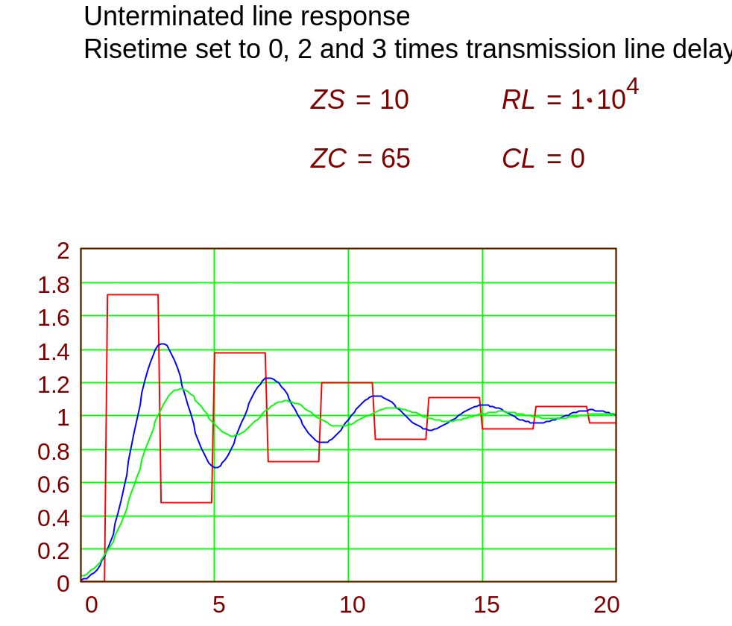
ECL
time, in units of line delay

Slide 4
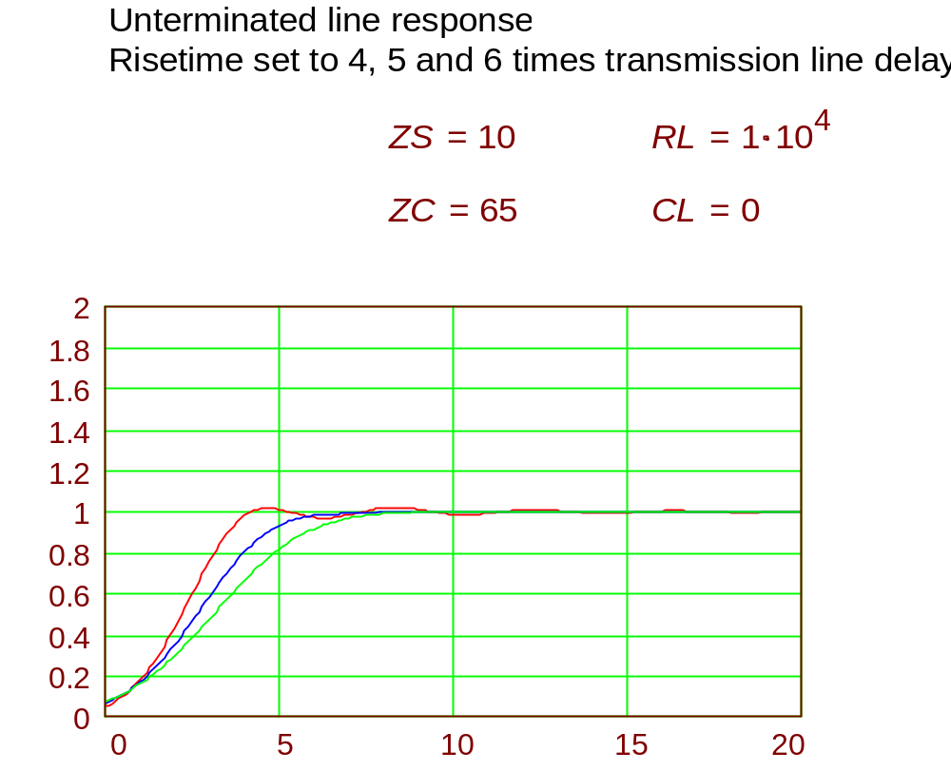
ECL
time, in units of line delay

Slide 5
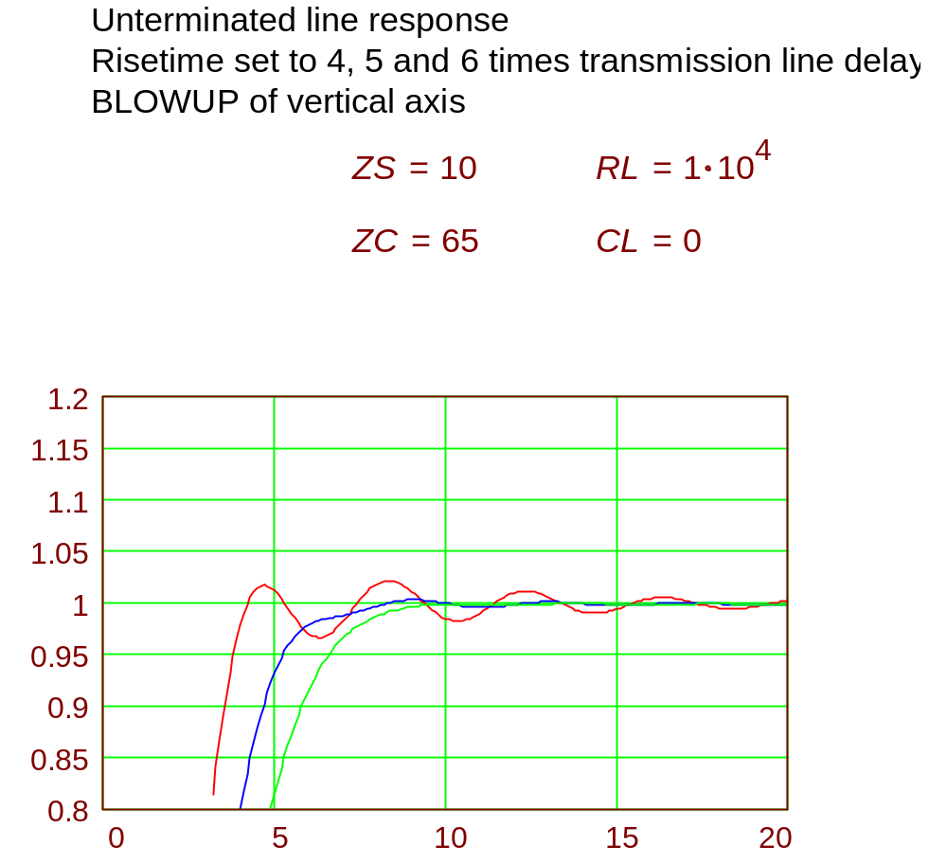
ECL
time, in units of line delay

Slide 6
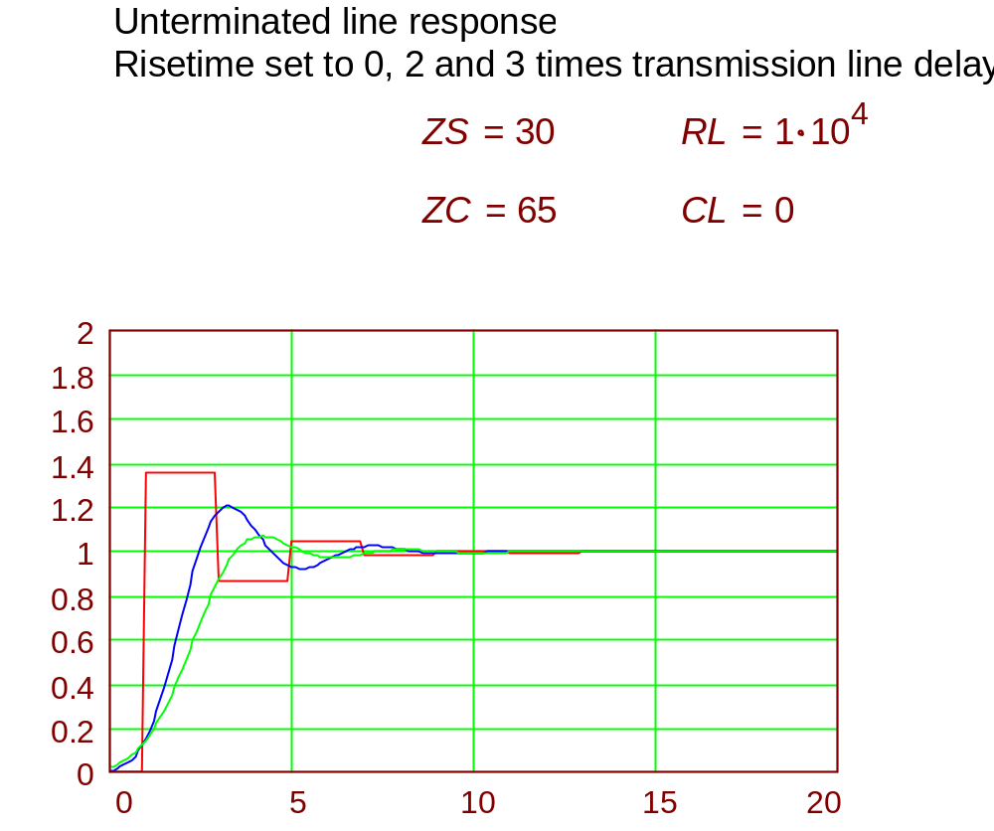
TTL/CMOS
time, in units of line delay

Slide 7
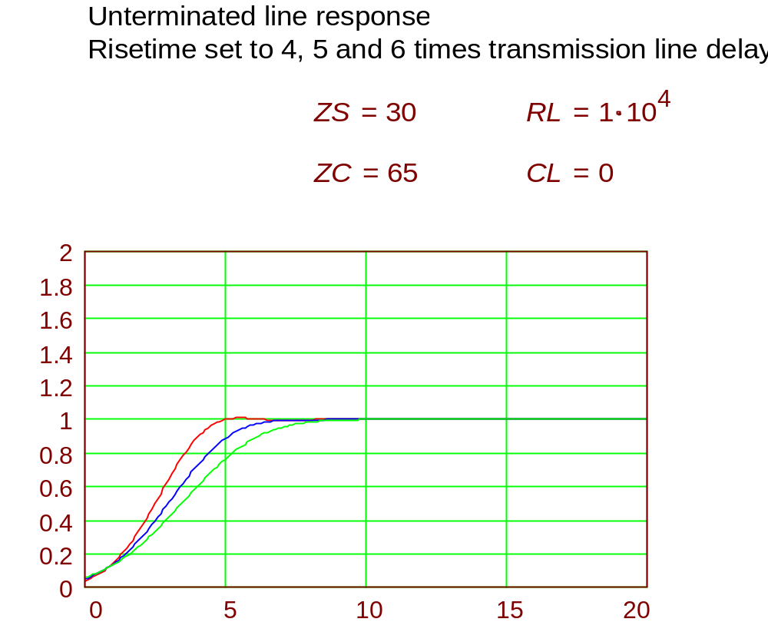
TTL/CMOS
time, in units of line delay

Slide 8
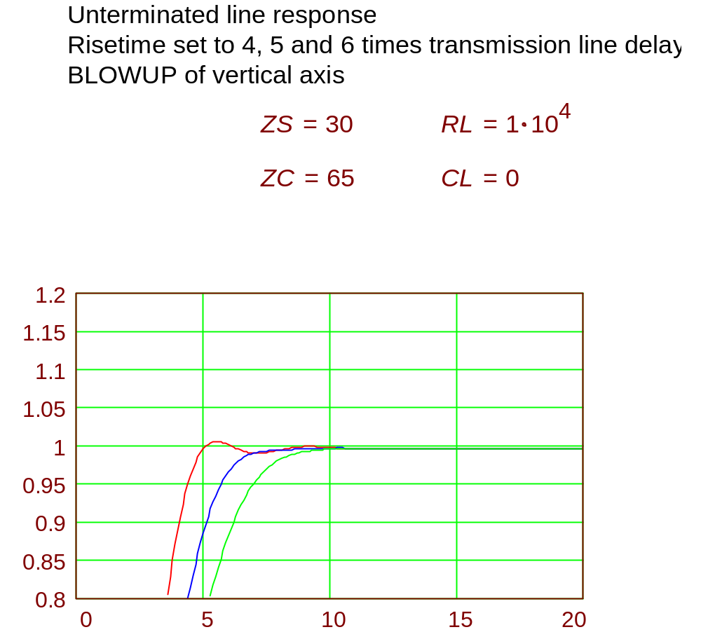
TTL/CMOS
time, in units of line delay

Slide 9
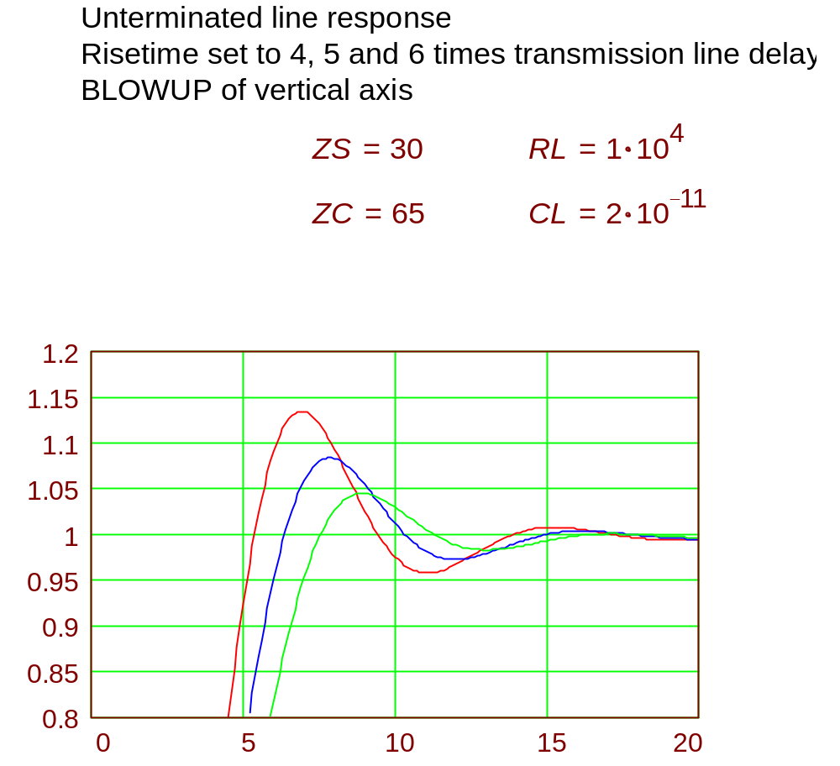
TTL/CMOS with Capacitive Load (20 pF)
time, in units of line delay

